Slide 1


Workshop on evaluating vaccine impact Evaluating Vaccine Impact using Time Series Data
Dan Weinberger, PhD
Epidemiology of Microbial Diseases
Yale School of Public Health

Slide 2
In this video
Trend analysis and building simple regression models
Interrupted time series analysis
How much data do you need to do this type of analysis?

Slide 3
How much does the rate of cases or deaths decline following vaccine introduction?

Slide 4
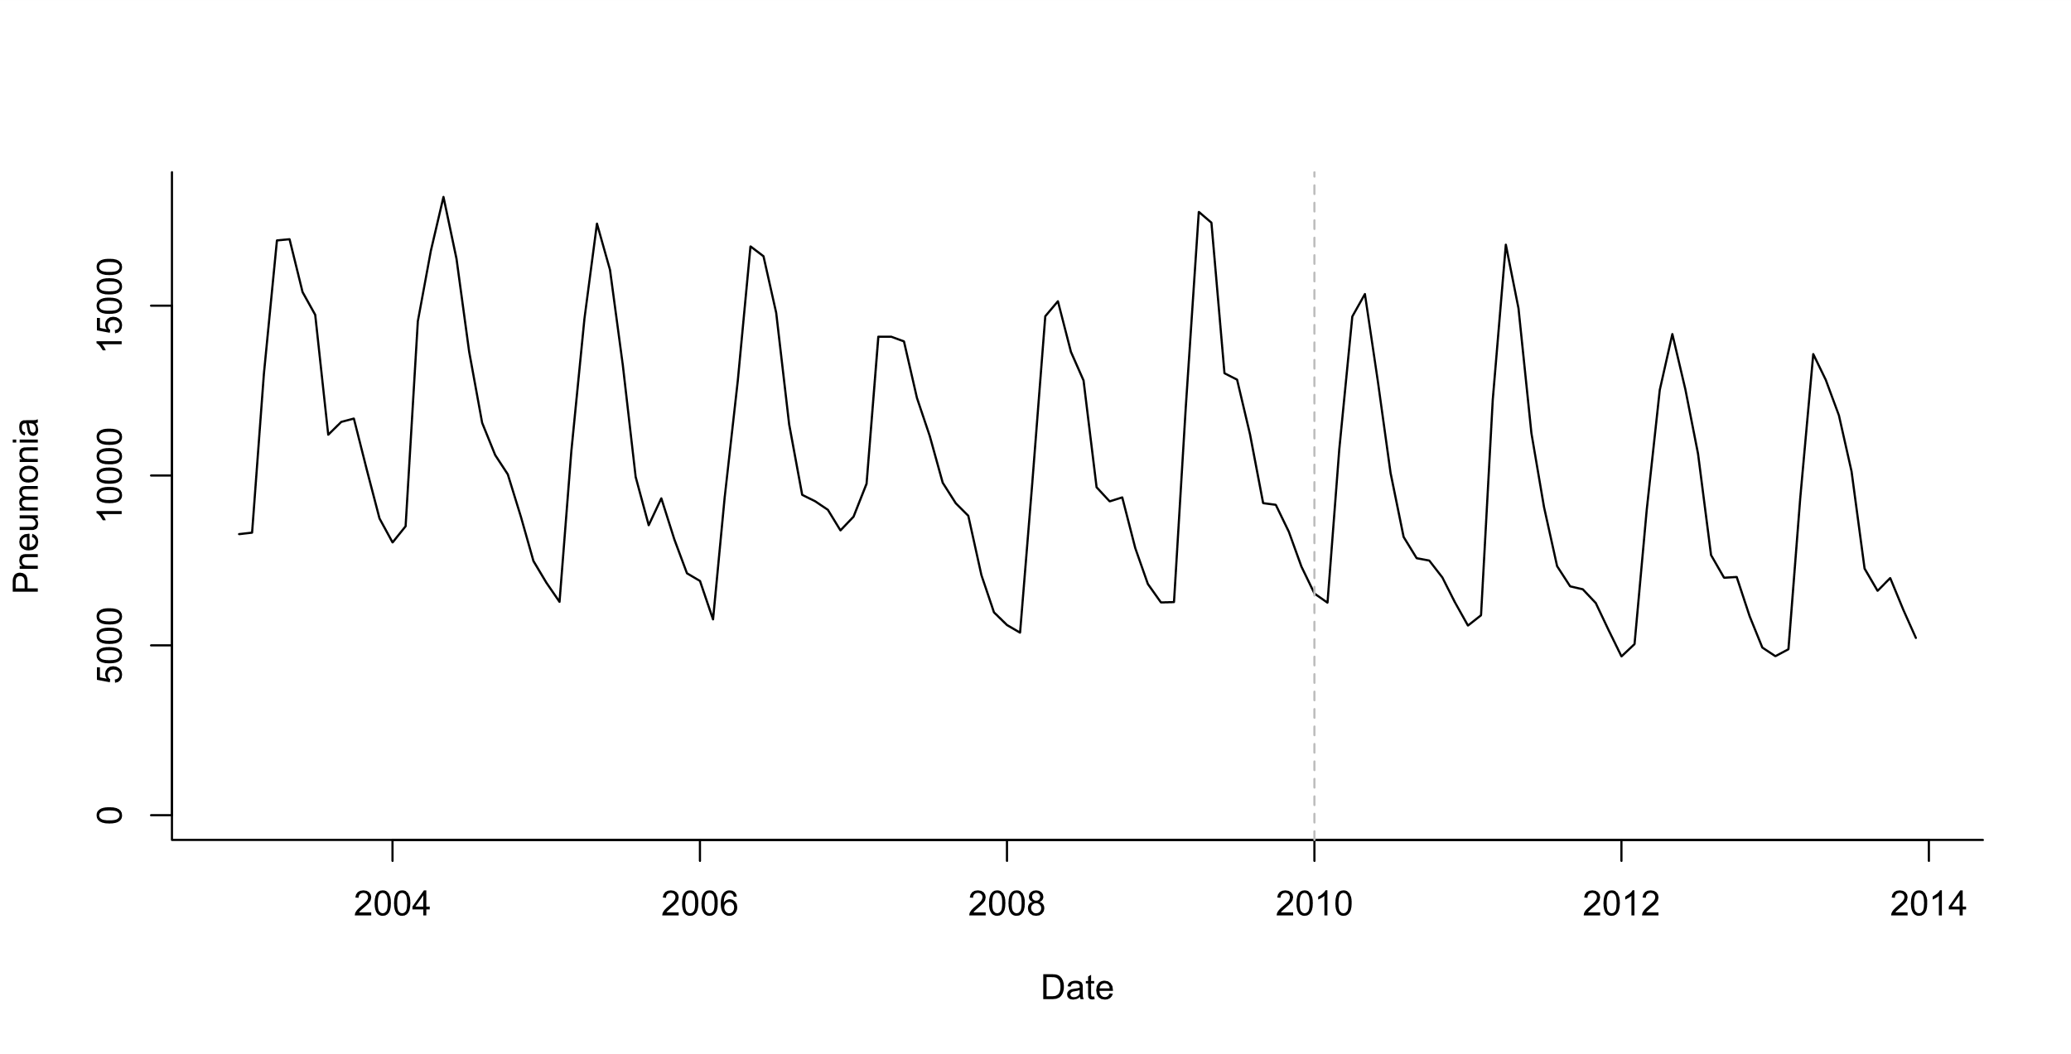
Estimating the effect of vaccine
Vaccine intro
“Counterfactual”
Vaccine effect
Pre-vaccine
Post-vaccine

Slide 5
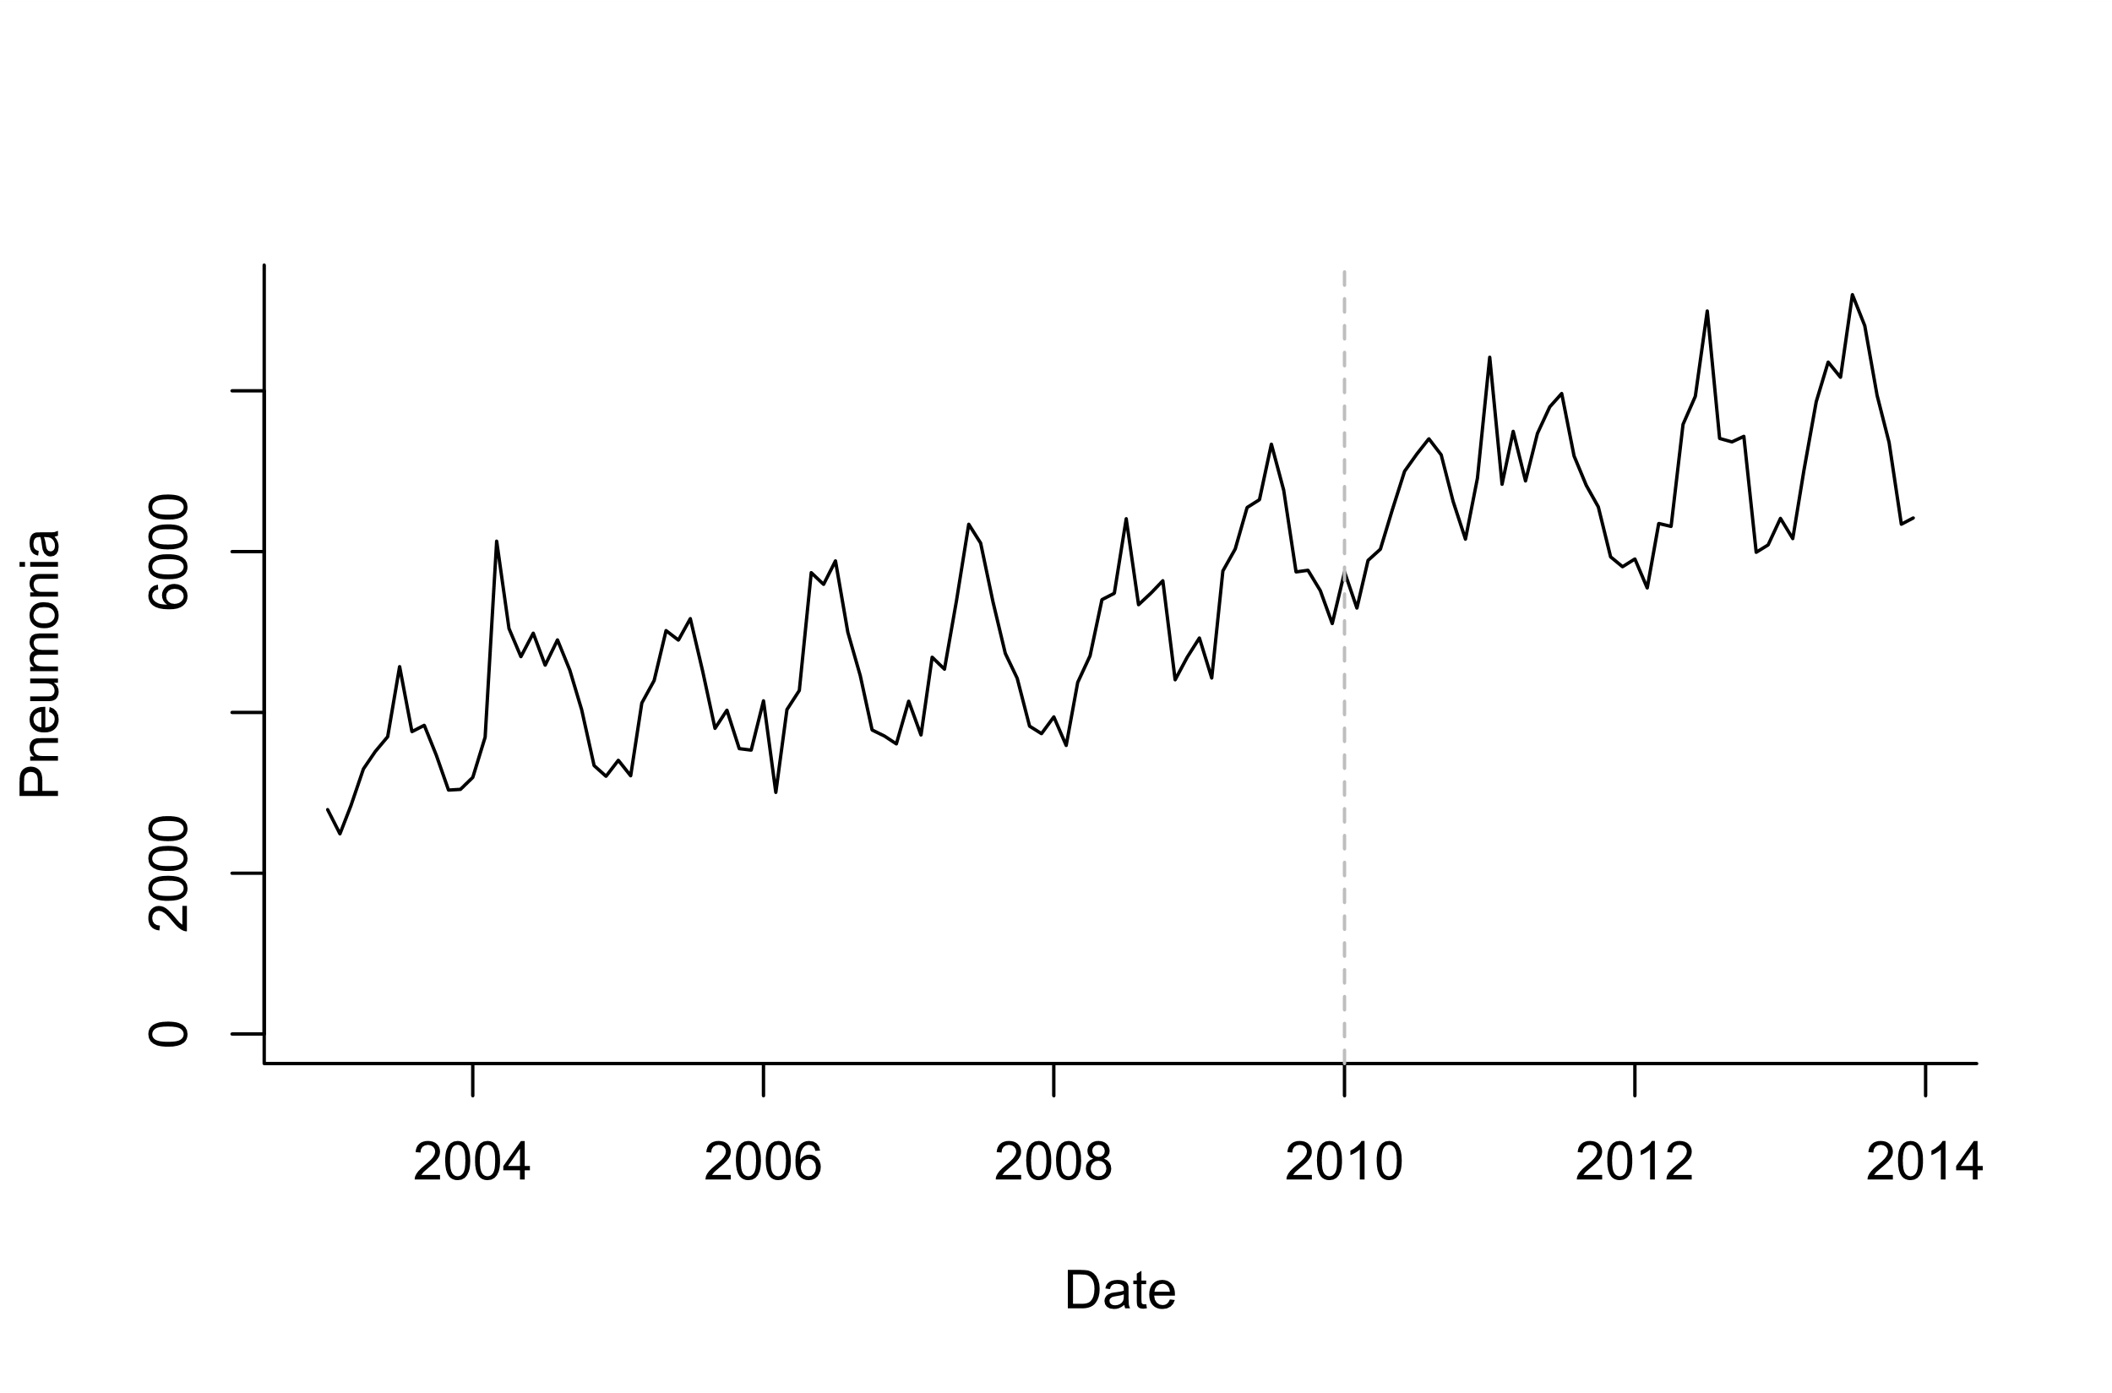
Estimating the effect of vaccine
?
Vaccine effect?
Pre-vaccine
Post-vaccine

Slide 6
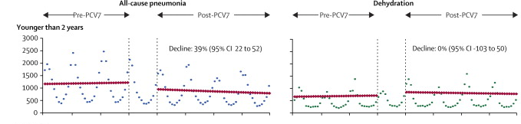
Example: Evaluating the impact of vaccines from time series
Counterfactual
Grijalva et al, The Lancet 2006
Pneumonia declines 39% compared to what would have been expected if not vaccine was introduced

Slide 7
Simple trend analysis
Fit a regression model (Poisson regression or negative binomial regression) to data from the pre-vaccine period
Extrapolate the model to the post-vaccine period (Counterfactual)
Compare the observed data and counterfactual estimates

Slide 8
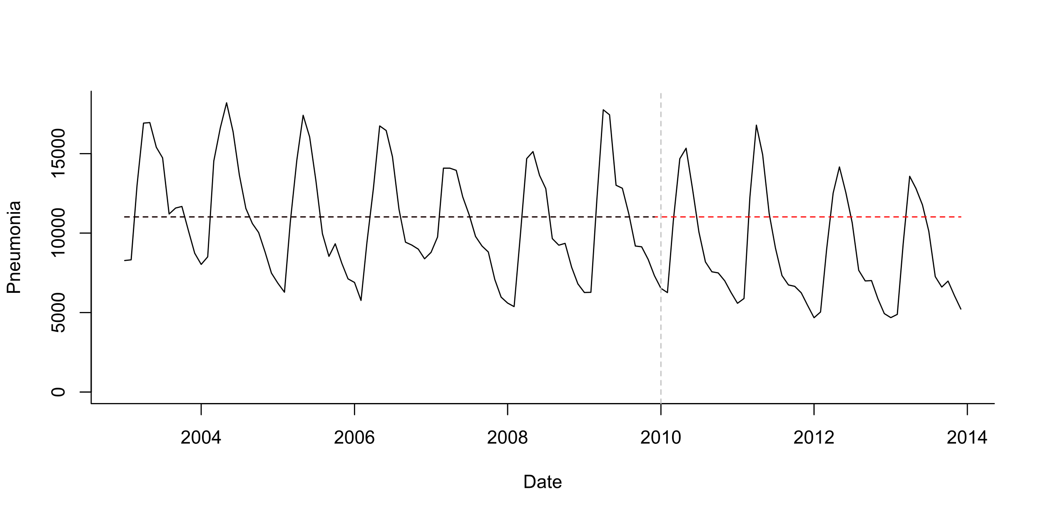
Pre-post analysis
Simple model:
Cases ~ Poisson (lambda)
Log(lambda)=b0
Simplest case: stationary data ; no trends, no seasonality
Test whether mean number of cases declines post-PCV

Slide 9
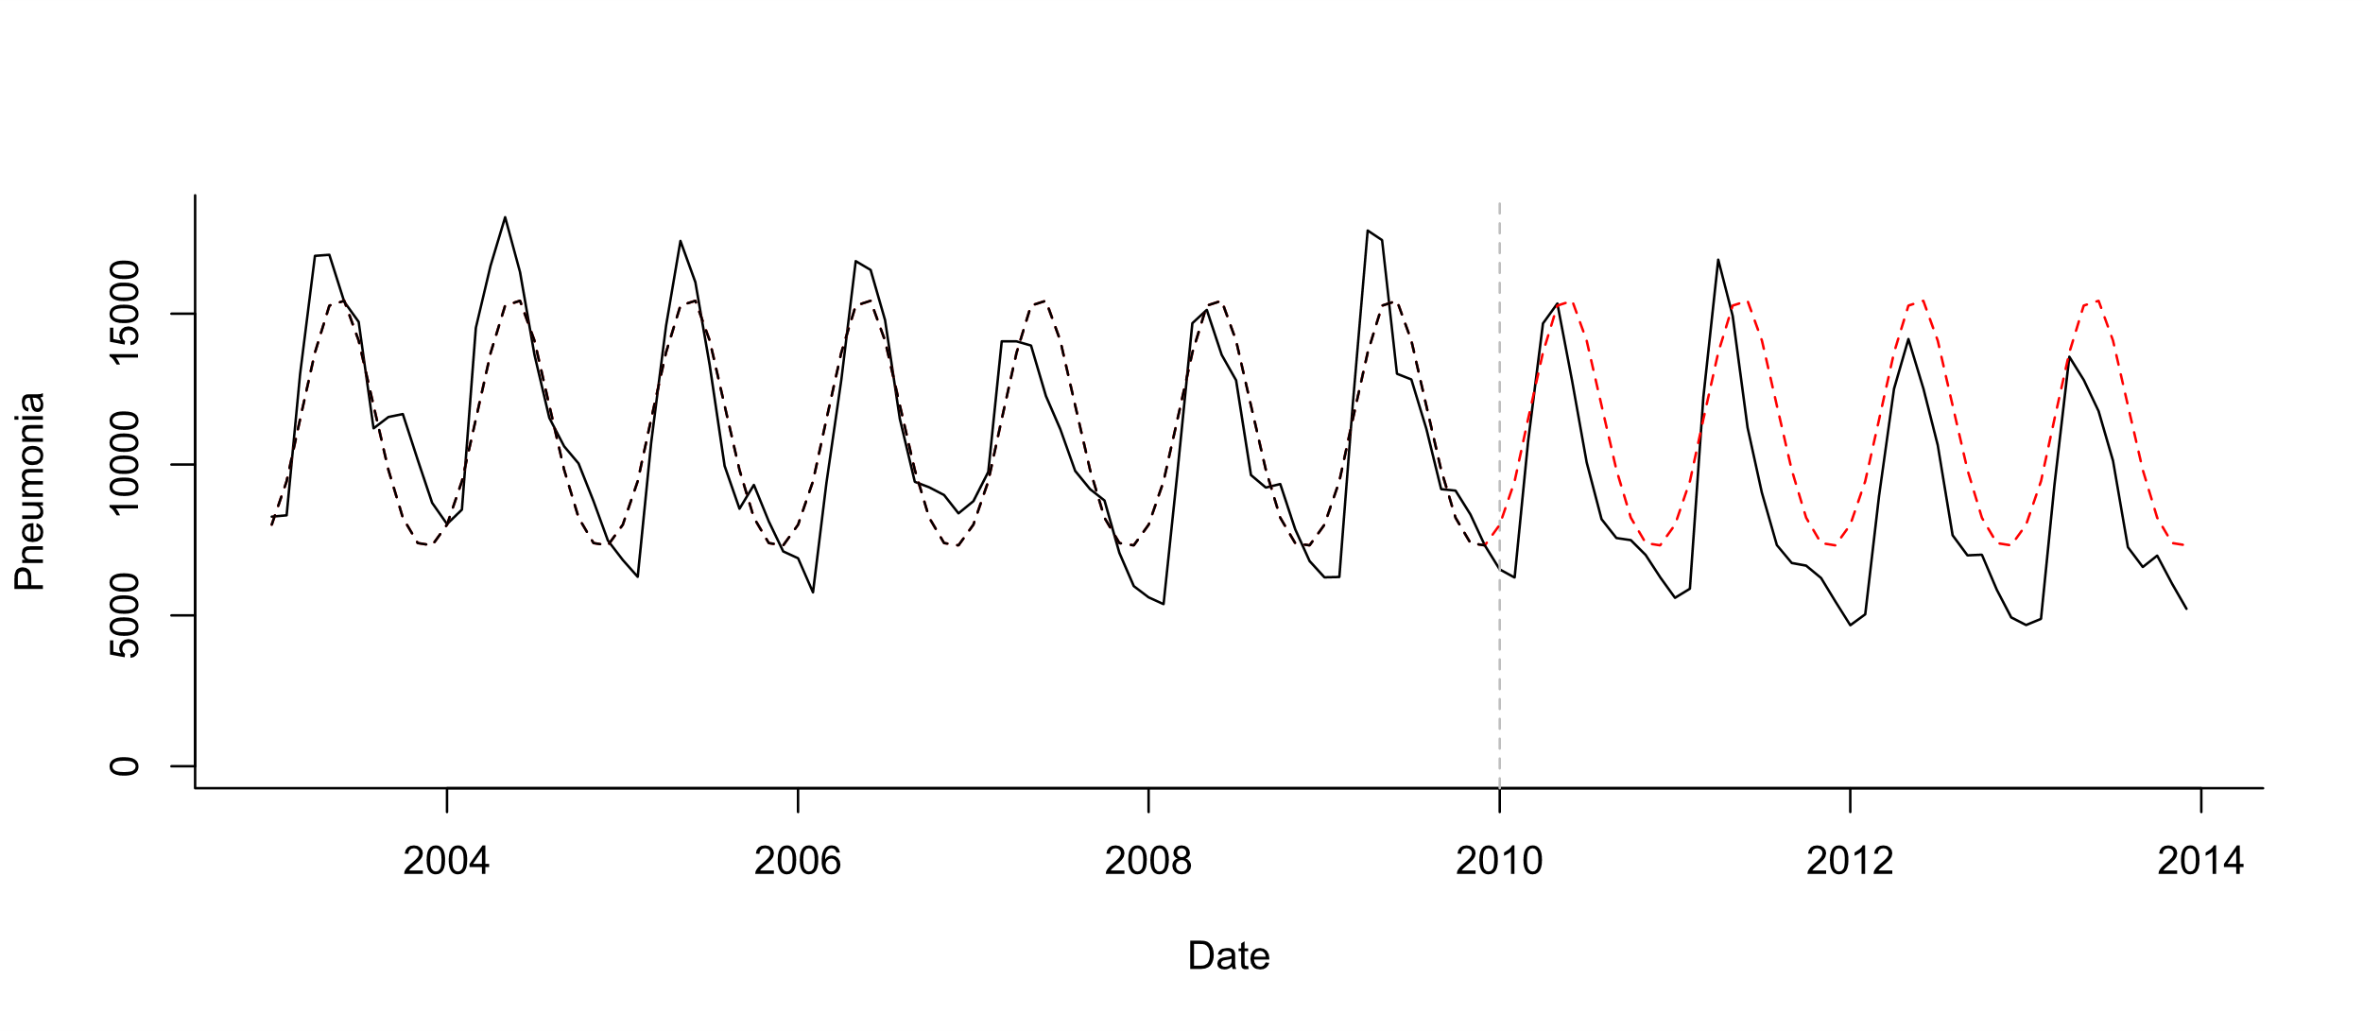
Pre-post analysis+seasonality
Seasonal model:
Cases ~ Poisson (lambda)
Log(lambda)=b0 +b1*sin12 +b2*cos12
Test whether mean number of cases declines post-PCV

Slide 10
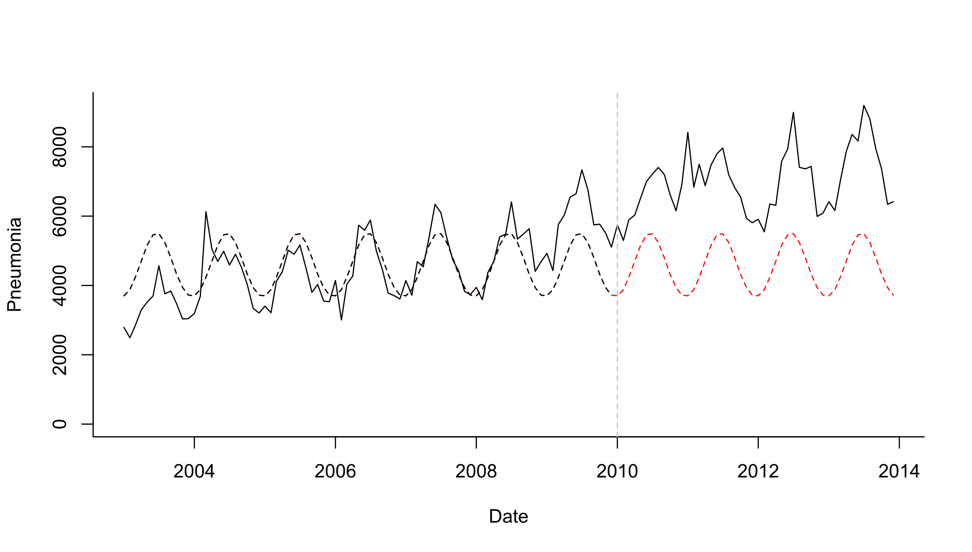
Pre-post analysis+seasonality
Seasonal model:
Cases ~ Poisson (lambda)
Log(lambda)=b0 +b1*sin12 +b2*cos12
Test whether mean number of cases declines post-PCV

Slide 11
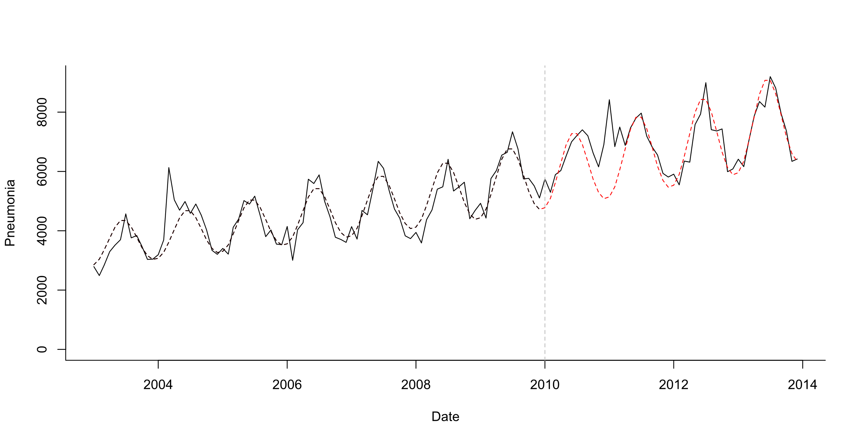
Pre-post analysis+seasonality + linear trend
Test whether mean number of cases declines post-PCV
Seasonal model:
Cases ~ Poisson (lambda)
Log(lambda)=b0 +b1*sin12 +b2*cos12 +b3*trend
What is your evaluation period?
Last 2 years? Last 3 years?

Slide 12
Interrupted time series analysis
Broad group of approaches
Fit regression model to entire time series and allow the slope of the line and the average number of cases (level) to change after vaccination
Can explicitly quantify how the vaccine effects the slope and level
Can generate counterfactuals by pretending the slope and level changes did not occur
Need to make or test assumptions about the timing of the decline and its shape (e.g., step change)

Slide 13
Interrupted time series (ITS)
Change in level postvaccine
Pre-vaccine slope
Change in slope postvaccine
Yt=exp(b+ a*t + c*z + d*t*z)

Slide 14
Interrupted time series (ITS)
Does slope significantly change at time q
Predicted value at time t: Yt=exp(b+ a*t + c*z + d*t*z)
Counterfactual at time t: Yt=exp(b+a*t)
Difference or ratio between observed and counterfactual lines gives the “Vaccine impact” (rate ratio or rate difference)

Slide 15
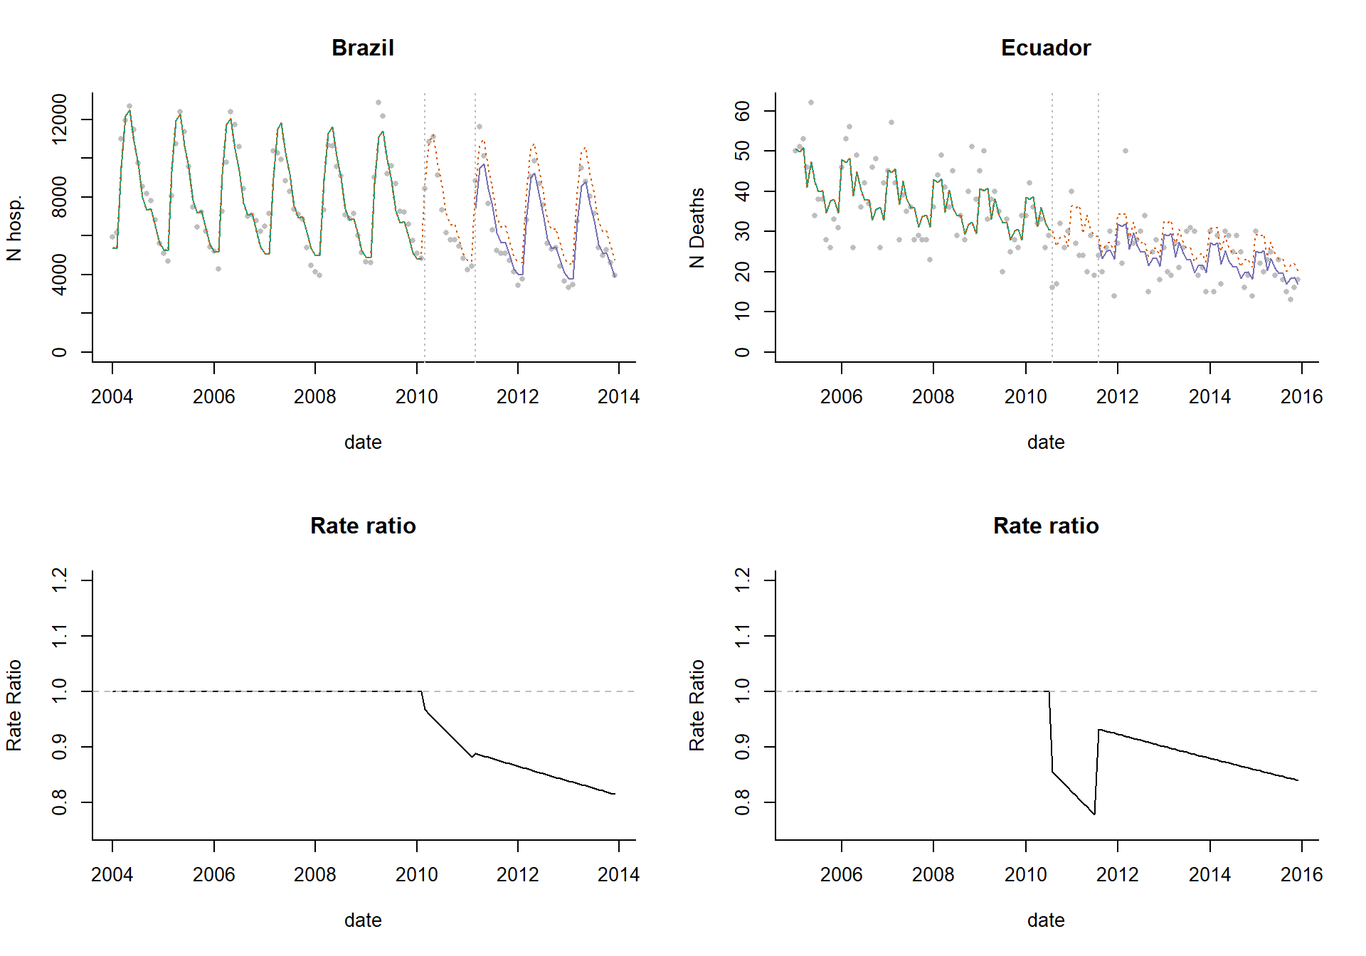
Disjointed ITS
No requirement that the different segments connect

Slide 16
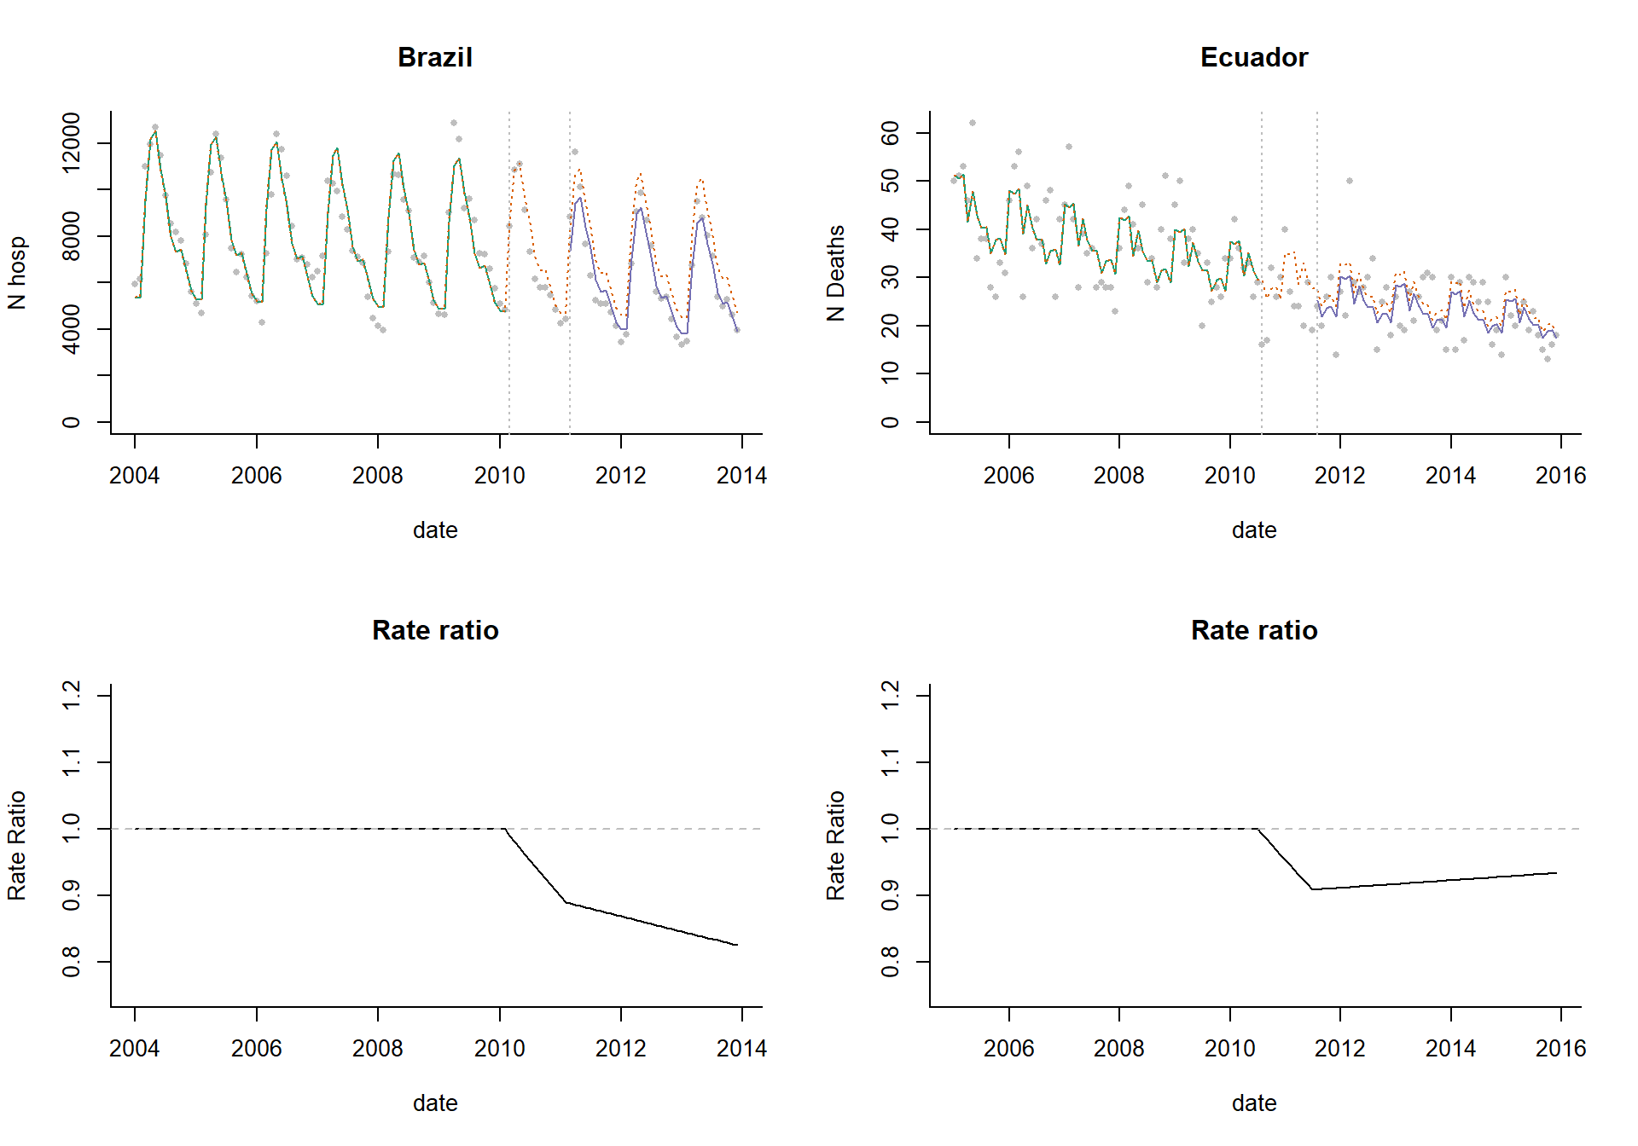
ITS with connected segments
Requires the segments to connect

Slide 17
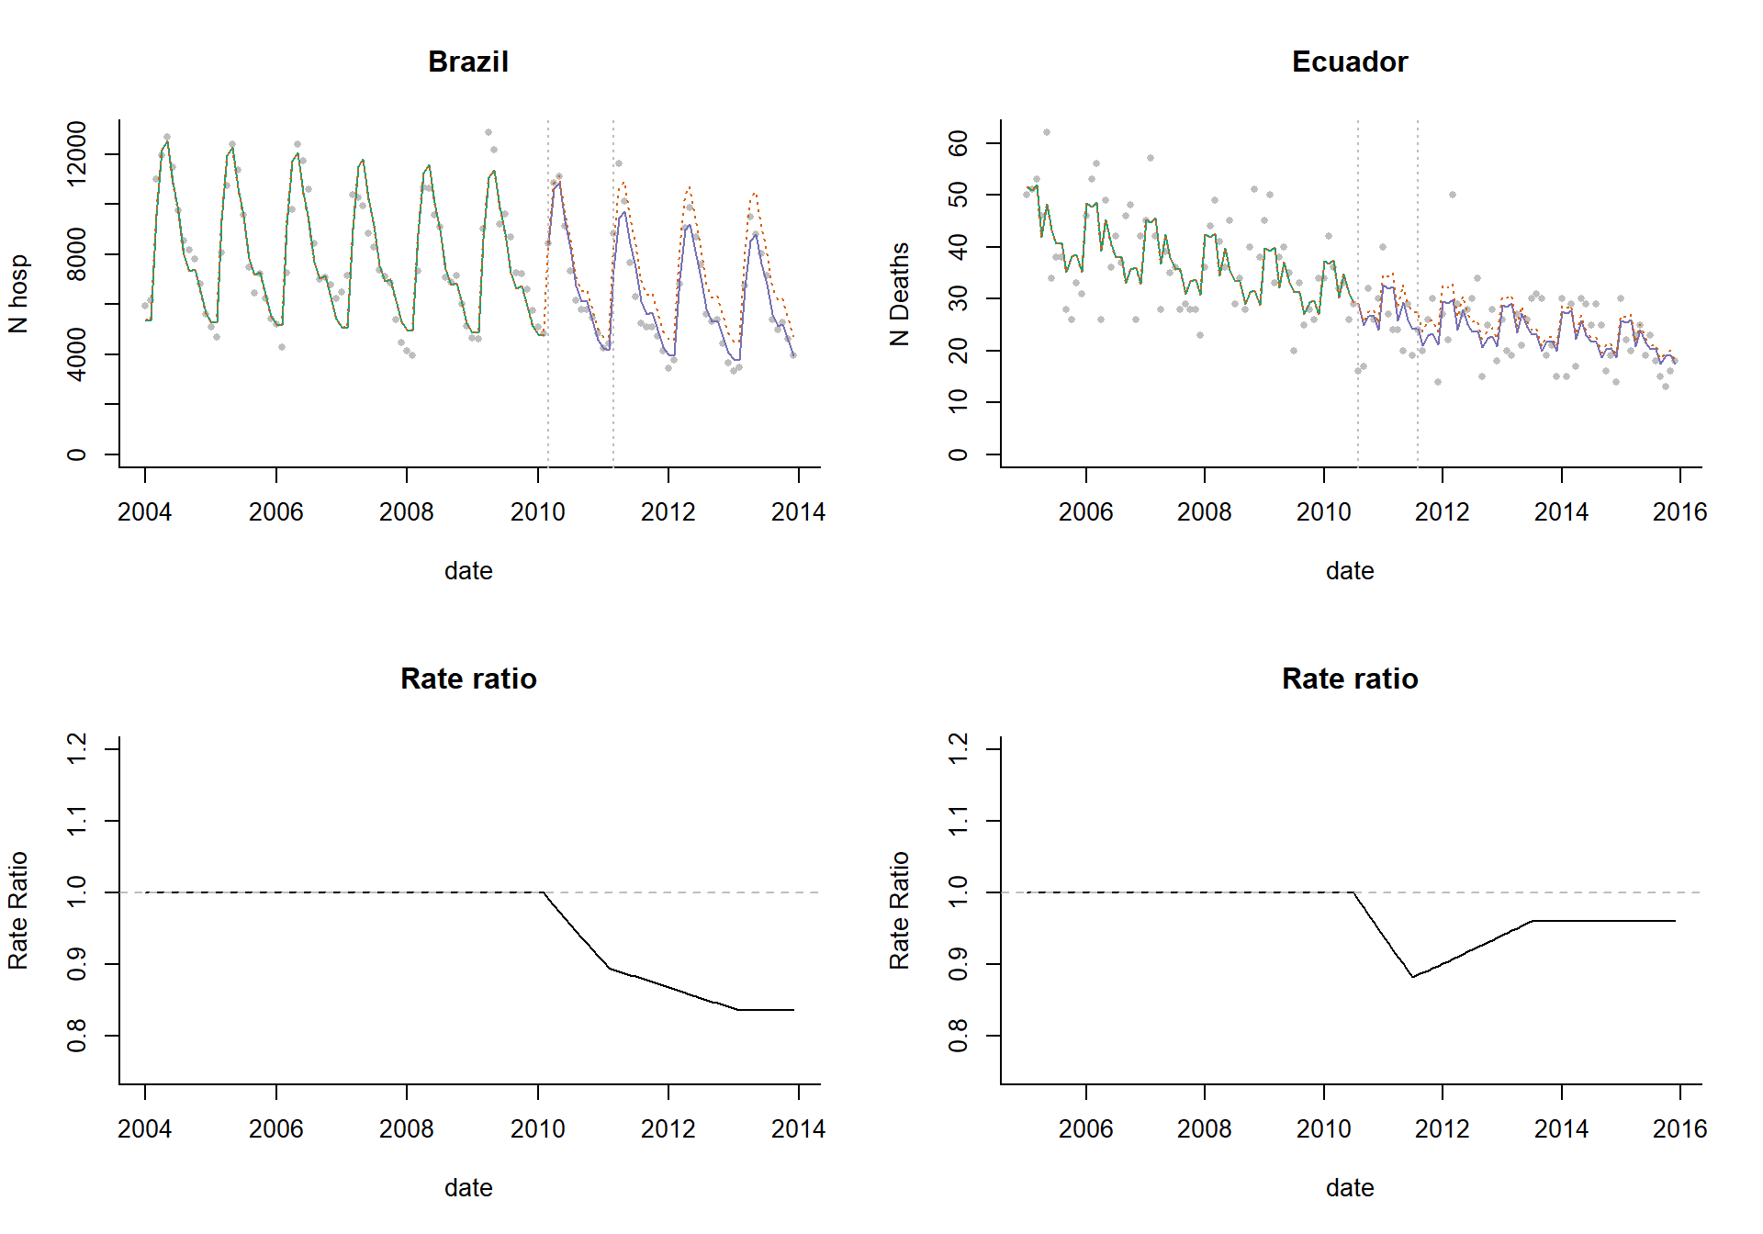
ITS with leveling of the slope
Requires segments to be connected, and assumes changes will stabilize after a specified amount of time

Slide 18
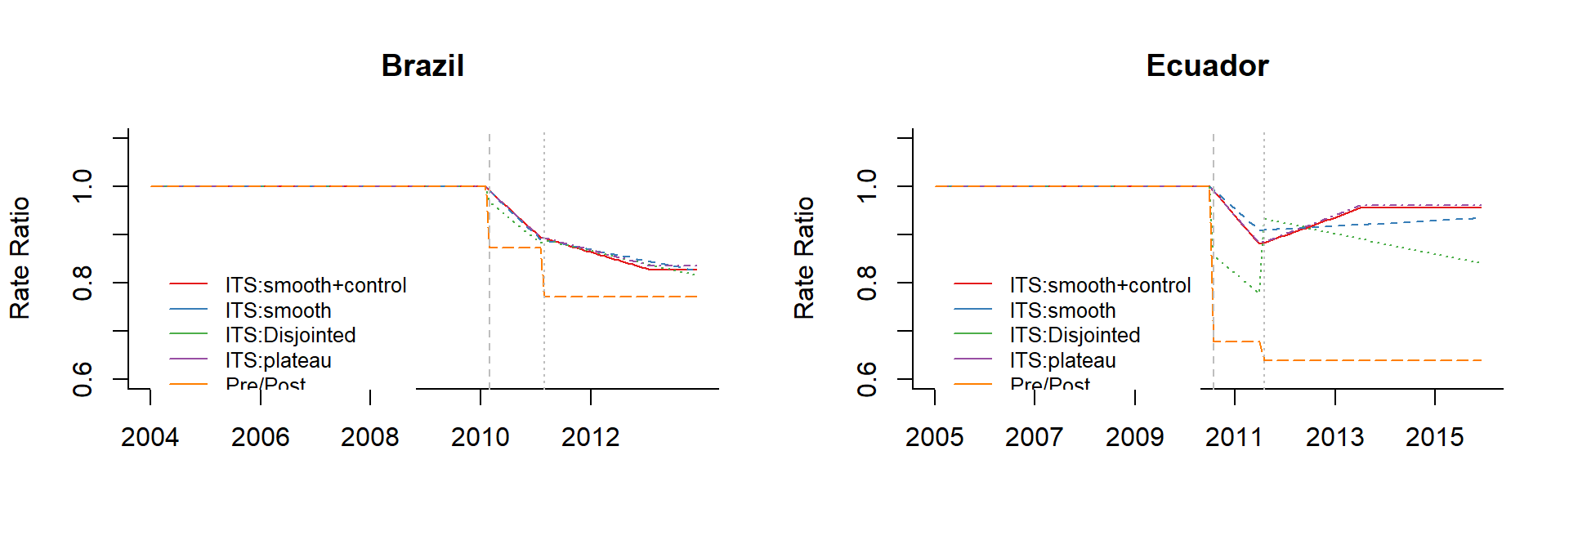
How much do these different assumptions matter?
-It depends on the dataset
-Pre/post is almost always wrong

Slide 19
Steps for evaluating performing interrupted time series analysis
Define “baseline”, transition periods
Determine whether there are any trends or patterns in the baseline period
Seasonality, etc
Fit a model to your baseline data using regression
Be wary of over-fitting (use AIC)
Evaluate model parameters
Compare fitted with counterfactual values to estimate impact
THINK ABOUT WHAT COULD GO WRONG:
Identify controls!
Do sensitivity analyses!
i.e., leave out one season at a time; try different intervention times

Slide 20
Sensitivity analyses you should consider
Never trust your main analyses without “pressure testing” it
Try different intervention dates—how does it influence your estimate?
Leaving out different seasons when fitting, see if it changes the answer

Slide 21
How much data do you need for a trend analysis?

Slide 22
Ability to detect a vaccine-associated decline
Depends on:
Size of the expected decline (ie a 40% decline is easier to see than a 10% decline)
Amount of unexplained variability in the data

Slide 23
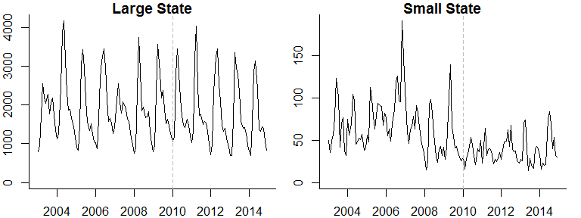
Pneumonia hospitalizations (N)

Slide 24
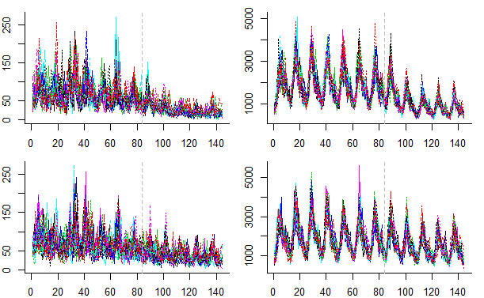
Simulated time series for a large and small state
20 Simulated time series for a small state
20 Simulated time series for a large state
50% reduction
20% reduction
https://weinbergerlab.shinyapps.io/ITS_Poisson_Power/

Slide 25
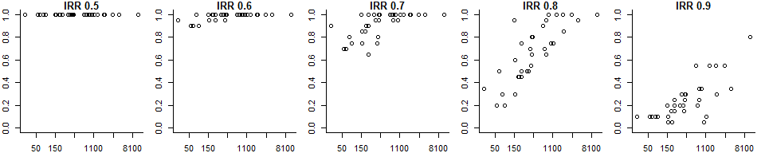
Power to detect a vaccine effect
Each dot on the plots below represents 1 of the 27 states
Each plot represents a different expected vaccine effect
Power: Percent of the simulations for which 95% CI for the rate ratio does not include 1
Expected vaccine effect (IRR)
Power
Average cases/month pre-PCV
With a smaller vaccine effect, only large states have adequate power
With a strong vaccine effect, even small states have excellent power to correctly detect the effect
All-cause pneumonia studies somewhere around here

Slide 26
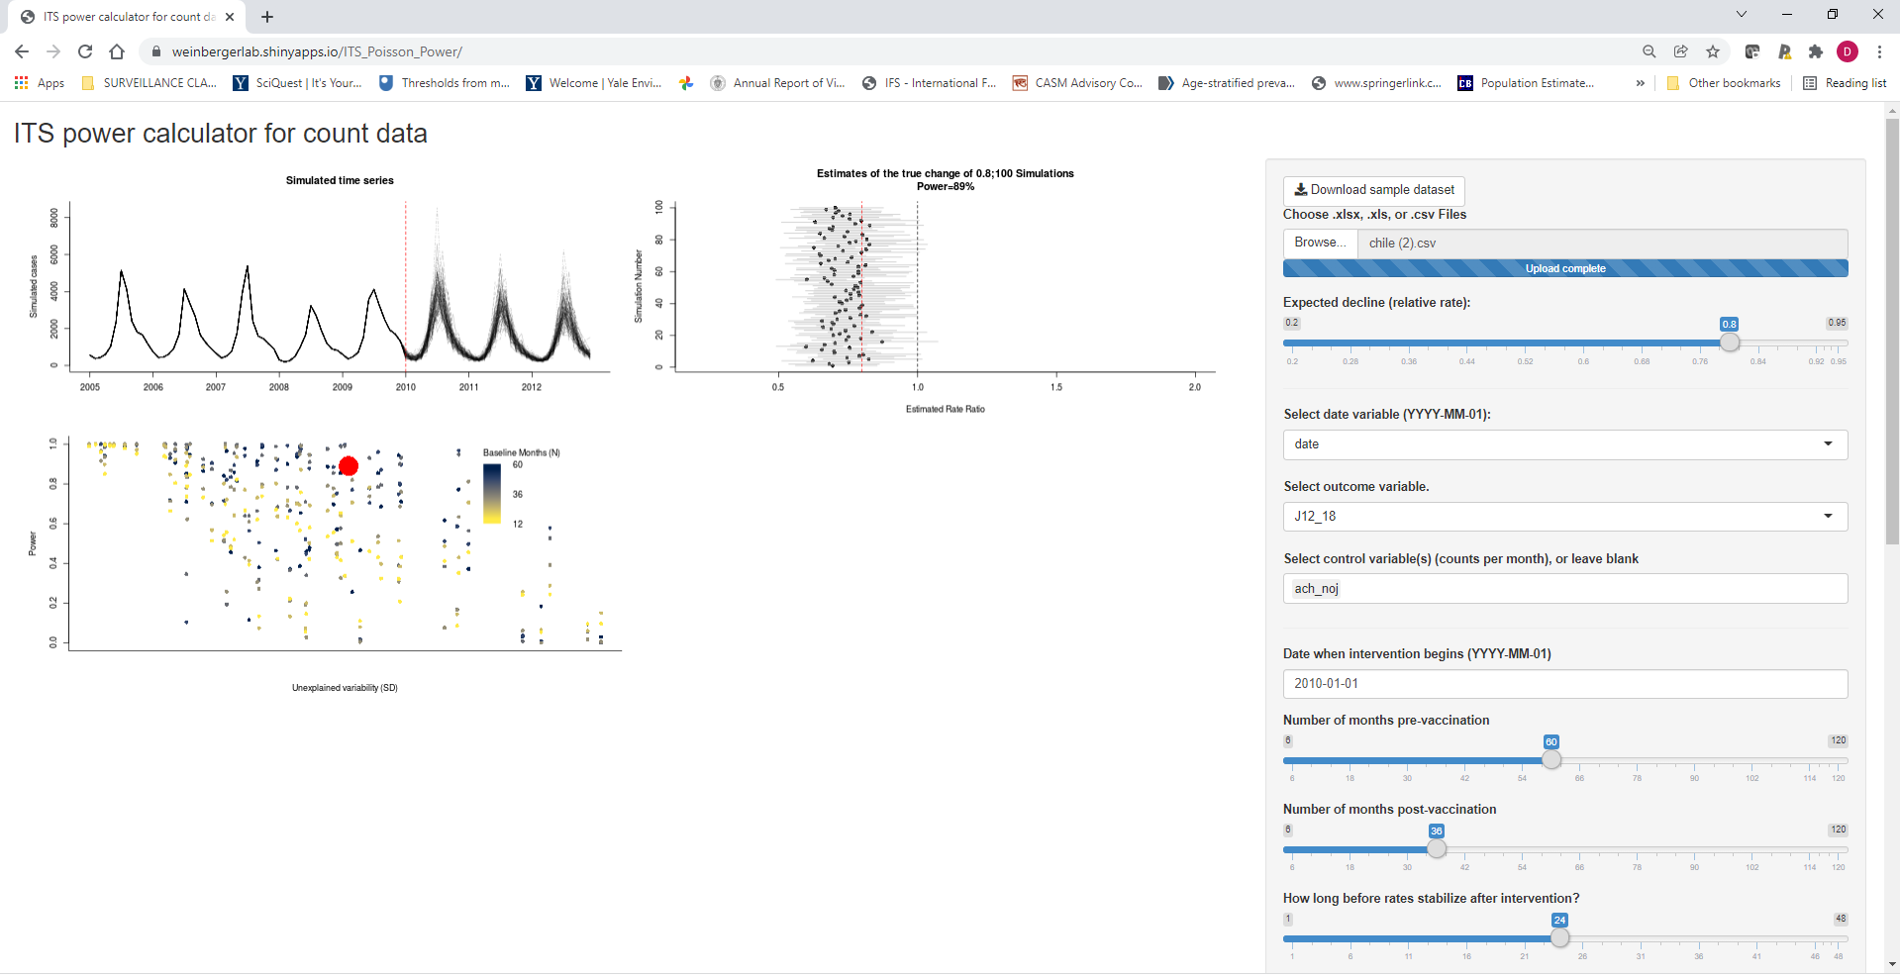
Perform simulations to see how likely it is that you would detect a decline
https://weinbergerlab.shinyapps.io/ITS_Poisson_Power/

Slide 27
Summary
Interrupted time series use linear trends to adjust for factors unrelated to vaccinations and to measure changes in the frequency of disease that occurs after vaccine introduction
The accuracy of these estimates and ability to measure it depends on the expected size of the decline and the amount of unexplained variation (noise) in the data
Typically have more noise in datasets from smaller populations

Slide 28
What else could go wrong with analyses?
Epidemic before or after vaccine introduction (biases slope estimates)
Ie 2009 pandemic, then introduce PCV in 2010
Insufficient data in pre- or post-period to accurately estimate trend
Unrelated changes that coincide with vaccine introduction
Delayed rollout of vaccine/low uptake
Many, many other issues that you can’t predict…

Slide 29
Up next: live sessions
1) Introduction to interrupted time series methods in R
2) Case study on evaluating the impact of PCVs in The Gambia, using R

